Slide 1

A Novel Approach On Ayurveda Tridosha Prediction On Big Data Environment
Supervised by:
Mr. Ashutosh Shankhdhar
Group Members:
Achal Paliwal 181500032
Shashank Gupta 181500653
Department of Computer Engineering and Applications
GLA University, Mathura
Uttar Pradesh, India

Slide 2

Mentor
Mr. Ashutosh Shankhdhar
Assistant Professor
Institute of Engineering & Technology
Department
Department of Computer Engineering & Applications

Slide 3


Our Team
Achal Paliwal
achal.paliwal_cs18@gla.ac.in
Bachelor of technology in computer science
GLA UNIVERSITY MATHURA (U.P)
Shashank Gupta
shashank.gupta_cs18@gla.ac.in
Bachelor of technology in computer science
GLA UNIVERSITY MATHURA (U.P)

Slide 4
Overview Of Presentation:
Introduction
Motivation
Hardware And Software Requirement
4. Models
Dataset
5. Results
6. Scope for future works
7. References

Slide 5
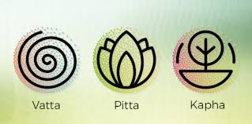
Introduction
In Ayurveda, Vata, Pitta and Kapha are known as the three doshas, or regulating forces of nature. Ayurvedic wisdom holds that equilibrium or balance of these three doshas is extremely important. In this project “ A Novel Approach On Ayurveda Tridosha Prediction On Big Data Environment ” we are predicting these three doshas according to the number of corresponding qualities that are expressed in the physical, emotional, and mental aspects of one’s being and according to the doshah the cure and diet for that particular dosha.

Slide 6
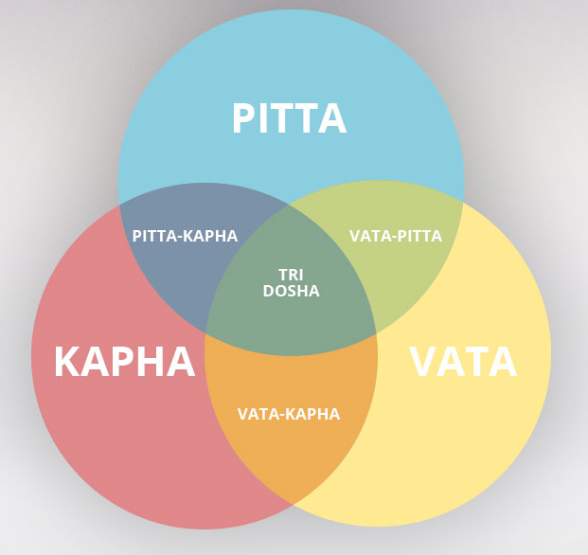
FIG. 1

Slide 7
Motivation
“As we all know that Ayurveda field is vast and increasing with technologies also and the doshas are the main principles in Ayurveda so to check these doshas directly and predicting the cure or diet accordingly we have selected this project.”

Slide 8

Dataset-
For this project we have collected data manually in our data there are 33 insights which are useful to predict Doshas .

Slide 9
Methodology-
In this project we have used decision tree algorithm on which we have trained our data.
A Decision Tree is constructed by asking a serious of questions with respect to a record of the dataset we have got. Each time an answer is received, a follow-up question is asked until a conclusion about the class label of the record. The series of questions and their possible answers can be organised in the form of a decision tree, which is a hierarchical structure consisting of nodes and directed edges. A tree has three types of nodes:
root node that has no incoming edges and zero or more outgoing edges.
Internal nodes, each of which has exactly one incoming edge and two or more outgoing edges.
Leaf or terminal nodes, each of which has exactly one incoming edge and no outgoing edges.

Slide 10
Structure : -
root
LLeaf node
LLeaf node
Vata
Kapha
Pitta
Vata
Kapha
Pitta

Slide 11
Hardware And Software Requirements
Hardware Requirements
• Processor - Intel i5
• Operating System – Windows /8/10, Linux, Mac OS
• RAM – 4GB(minimum)
• Hard disk – 64 GB
• Hardware Devices – Computer System
Software Requirements
• Spyder /R Studio
• MS Excel

Slide 12

Timeline
Project Assigned and Discussion
February
Week 3 and 4
Research Paper Discussion
February
Week 2
Research Paper Analysis
February
Week 1
Intraction with Mentor
Week 4
January
Project Analysis
Week 2 and 3
January
Project Discussion
Week 1
January
12

Slide 13
Result
The outcome of this project is the information regarding what type of doshas the body has and in these doshas which one is imbalanced and which one is balanced. According to that dosha cure or diet suggestion to maintain the prakruti and do and don'ts.

Slide 14
References-
Mr. Vijay Jaiswal A new approach for recommending healthy diet using predictive data mining algorithm 2019
S Shilpa and C.G. Venkatesha Murthy Understanding personality from Ayurvedic perspective for psychological assessment 2016
Sanjeev Rastogi Building bridges between Ayurveda and Modern Science 2019
Dabur Ayurvedic Body Type 2021.
Vishu Madan Anjali Goyal , “Analysis and Synthesis of A Human Prakriti Identification System Based on Soft Computing Techniques ”.

Slide 15

Thank You.

